Slide 1
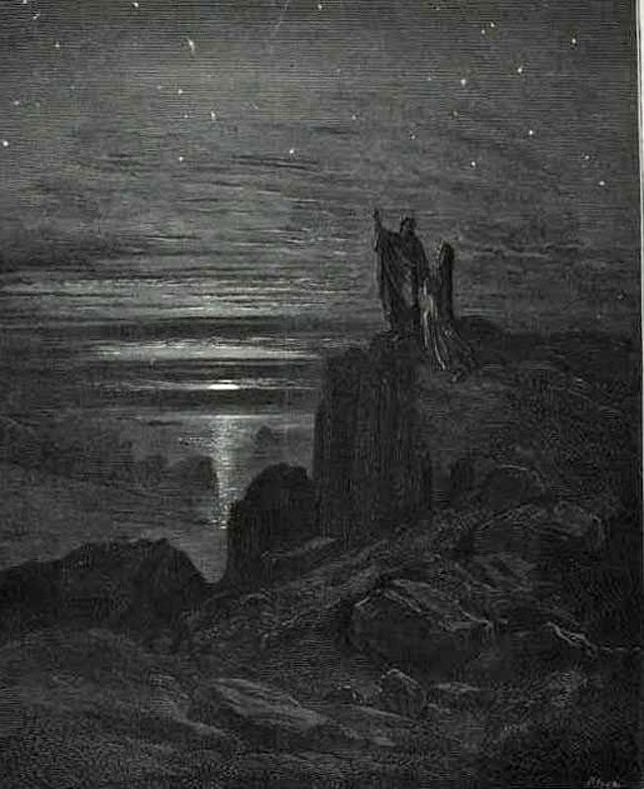
SEEING THE BEAUTY OF GOD: DANTE’S PARADISO
SRI Institute Day
Literature Breakout Session
Jennifer Newsome Martin, Ph.D.

Slide 2
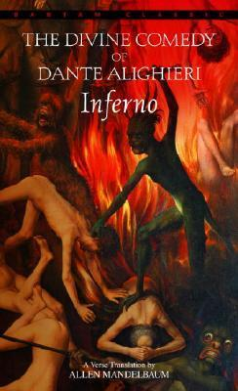
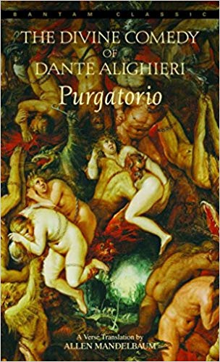
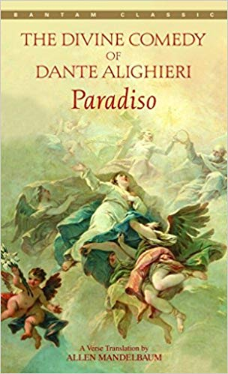
Dante’s Divine Comedy

Slide 3
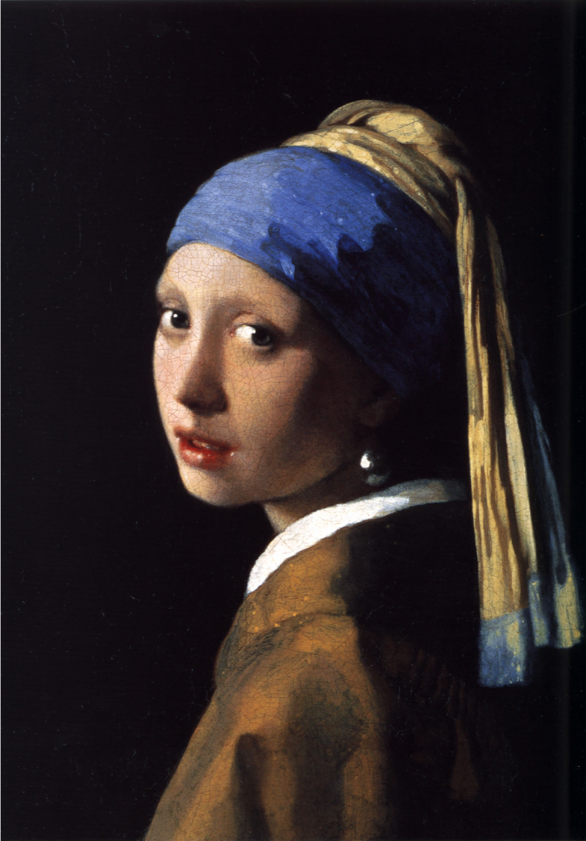
“aesthetics,” n.
a sub-category of philosophy that studies the phenomena of beauty and the beautiful, especially as applied to the fine arts; often prioritizes the subjective, emotional, and intellectual experience of beauty
Johannes Vermeer,
Girl with a Pearl Earring (1665)

Slide 4
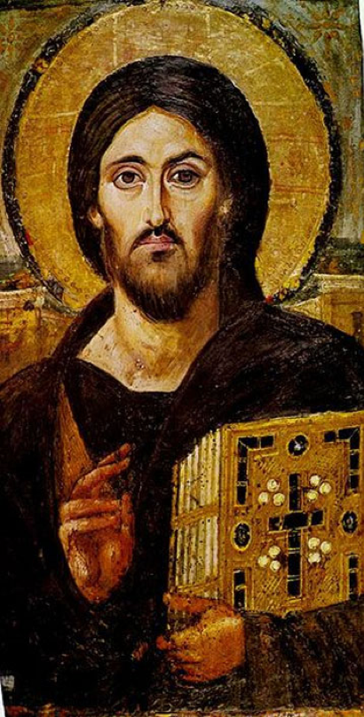
“theological aesthetics,” n.
The study of beauty, culture, the arts, and creativity through the lens of theological categories, which might include the doctrine of God as Trinity, the nature of revelation (how God reveals God’s Self to human beings), Christology, and pneumatology (the study of the Holy Spirit).
Bust of Christ Pantocrator, 6th century icon. The Monastery of Saint Catherine, Sinai.

Slide 5
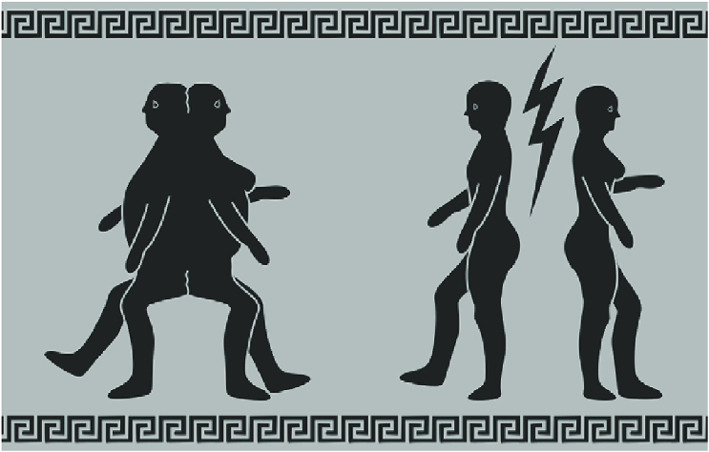
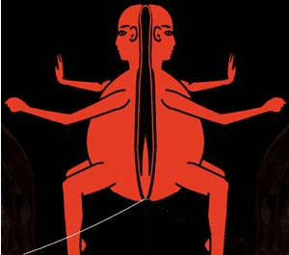
Plato’s Symposium (385 BC), The Speech of Aristophanes
“Love is born into every human being; it calls back the halves of our original nature together; it tries to makes one out of two and heal the wound of human nature”
(Plato, Symposium, 191D).

Slide 6
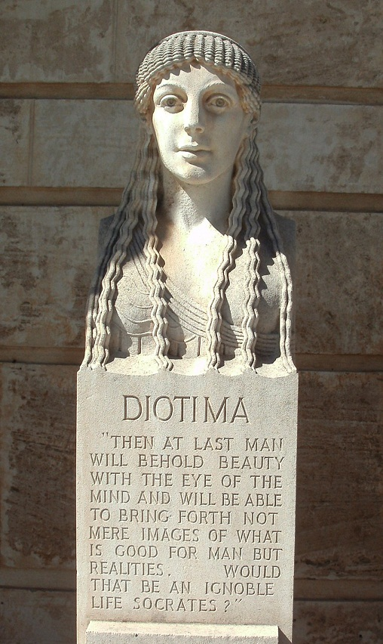
“You see, Socrates,” she said, “what Love wants is not beauty, as you think it is.”
“Well, what is it, then?”
“Reproduction and birth in beauty.”
“Maybe,” I said.
“Certainly,” she said. “Now, why reproduction? It’s because reproduction goes on forever; it is what mortals have in place of immortality. A lover must desire immortality along with the good, if what we agreed earlier was right, that Love wants to possess the good forever. It follows from our argument that Love must desire immortality.”
Plato, Symposium, 206E-207A

Slide 7
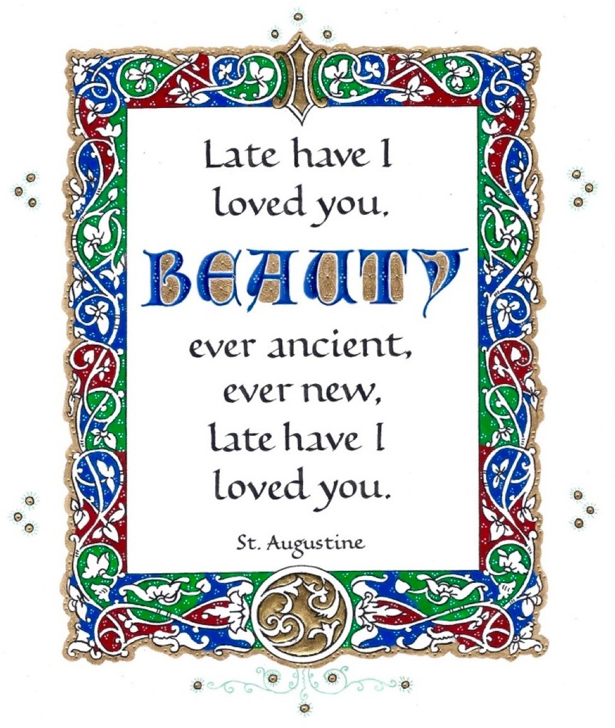
St Augustine, Confessions
"Late have I loved you, O Beauty ever ancient, ever new, late have I loved you! You were within me, but I was outside, and it was there that I searched for you. In my unloveliness I plunged into the lovely things which you created. You were with me, but I was not with you. Created things kept me from you; yet if they had not been in you they would have not been at all. You called, you shouted, and you broke through my deafness. You flashed, you shone, and you dispelled my blindness. You breathed your fragrance on me; I drew in breath and now I pant for you. I have tasted you, now I hunger and thirst for more. You touched me, and I burned for your peace.”

Slide 8
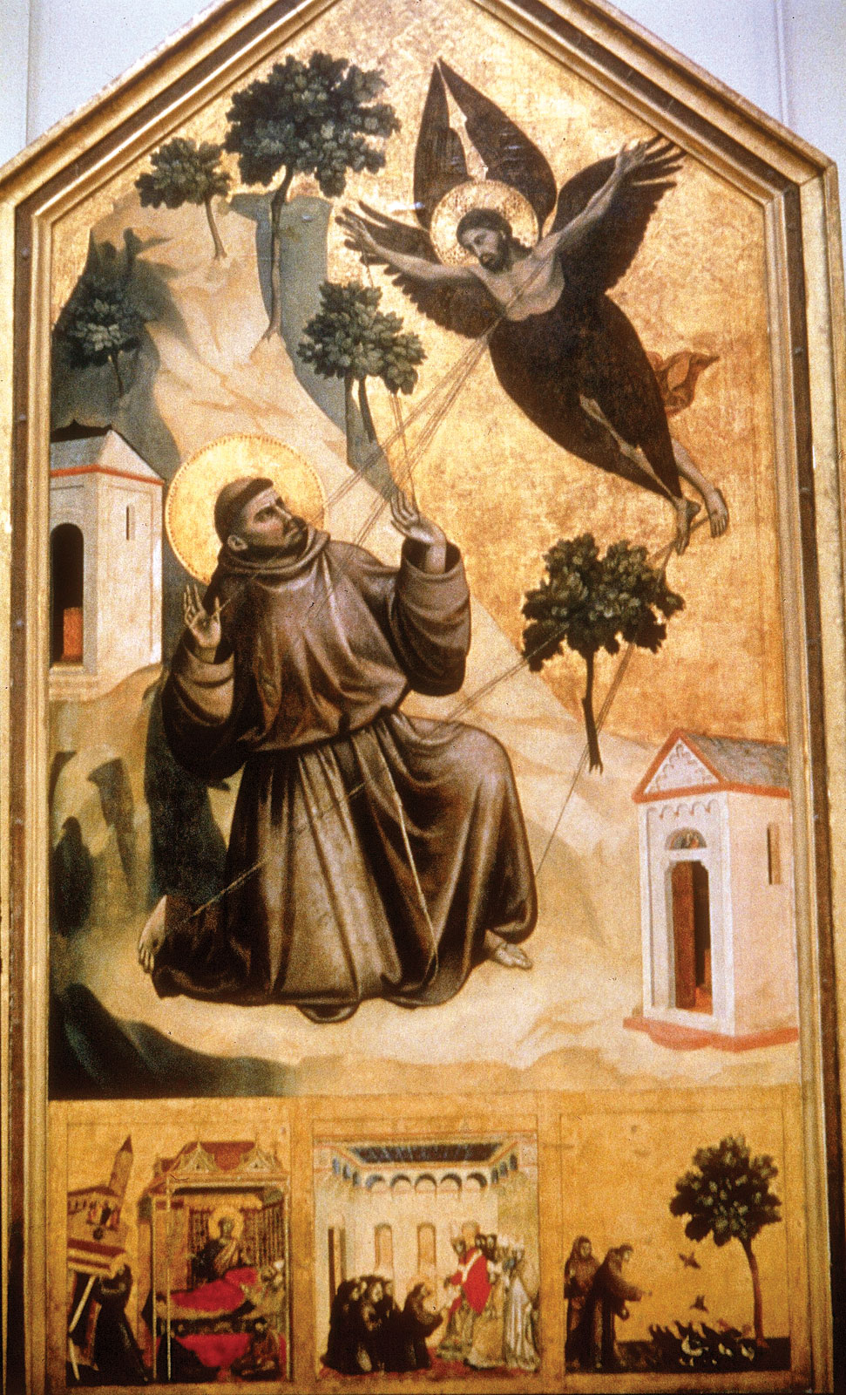
In beautiful things
He saw Beauty itself
and through his vestiges imprinted on creation
he followed his Beloved everywhere,
making from all things a ladder
by which he could climb up
and embrace him who is utterly desirable.
-St. Bonaventure
“Life of St. Francis”
Classics of Western Spirituality, 263

Slide 9
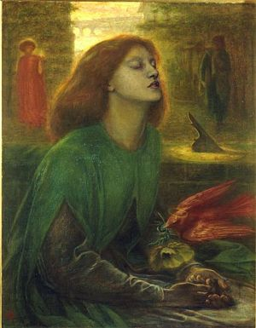
“My countenance sustained him for a while;
Showing my youthful eyes to him, I led
Him with me toward the way of righteousness.
As soon as I, upon the threshold of
my second age, had changed my life, he took
himself away from me and followed after
another; when, from flesh to spirit, I
had risen, and my goodness and my beauty
had grown, I was less dear to him, less welcome:
he turned his footsteps toward an untrue path;
he followed counterfeits of goodness, which
will never pay in full what they have promised.”
-Dante, Purgatorio, Canto XXX, 121-132
Dante Gabriel Rossetti, “Beata Beatrix” (1864)

Slide 10
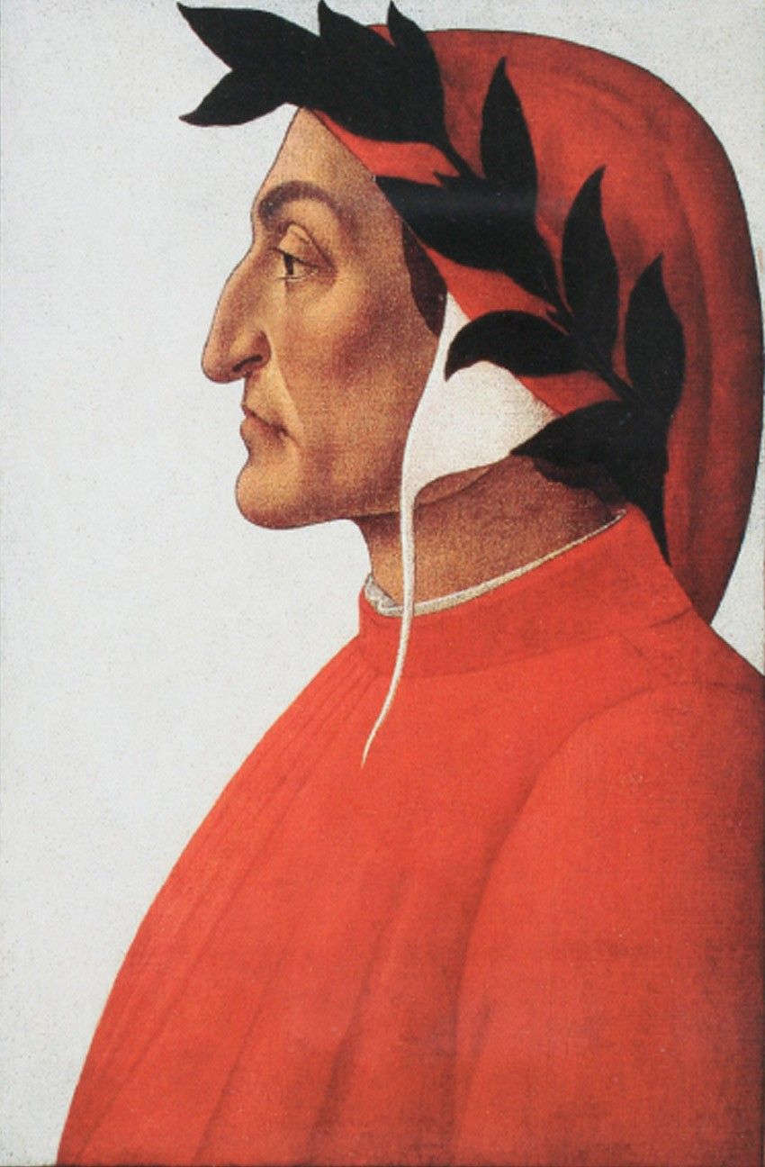
Aesthetic-Optical Themes in Dante’s Paradiso -Vision: The phenomenon of sight and Dante’s gradual strengthening of sight -Light and its reflection -Perspective -The relationship of subjective and objective (the seer and the seen)
Posthumous portrait of Dante,
Sandro Botticelli (~1495)

Slide 11
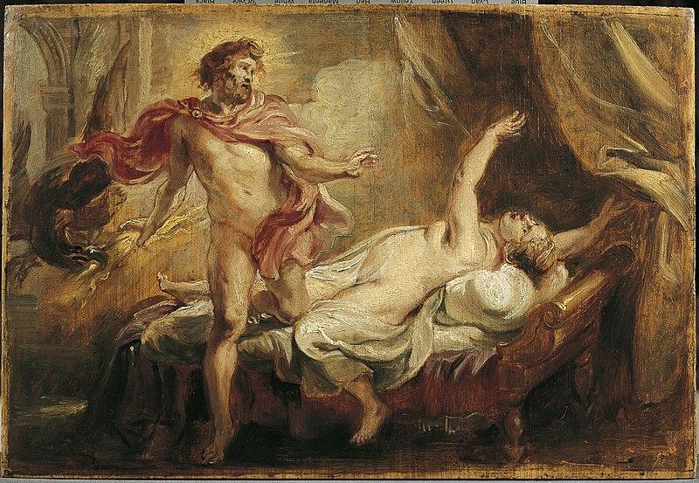
“Were I to smile, then you would be like Semele when she was turned to ashes, because, as you have seen, my loveliness—which, even as we climb the steps of this eternal palace, blazes with more brightness—that, as it flashed, your mortal faculty would seem a branch a lightning bold has cracked.”
Paradiso, Canto XXI, lines 5-12
Peter Paul Rubens, “Death of Semele”
Notes:
Peter Paul Rubens, “Death of Semele”

Slide 12
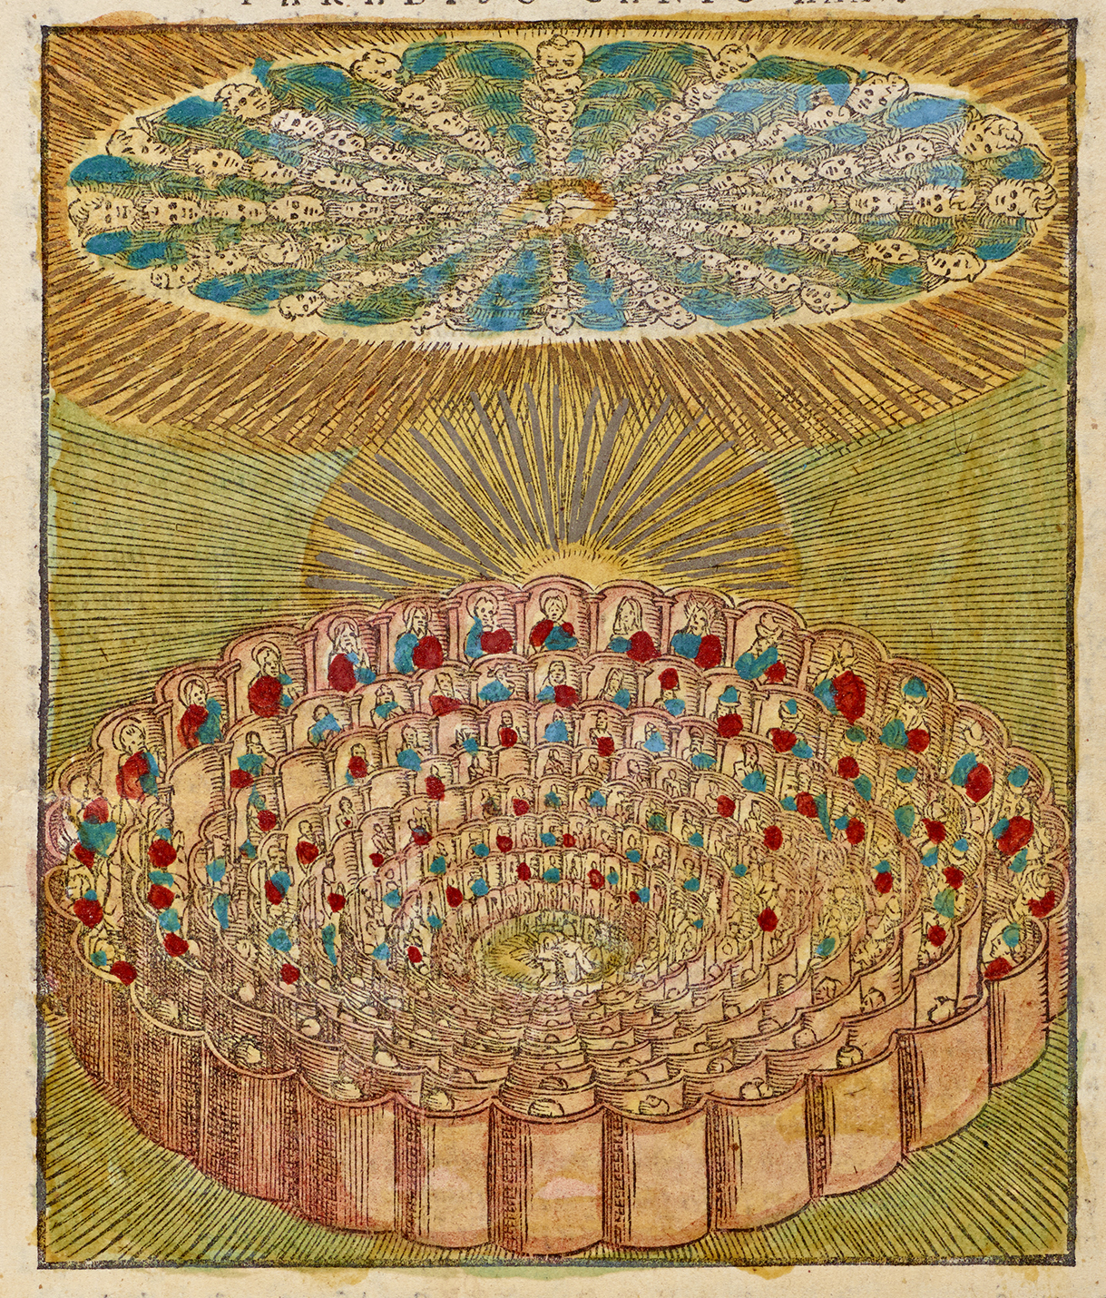
O radiance of God, through which I saw the noble triumph of the true realm, give to me the power to speak of what I saw! Above, on high, there is a light that makes apparent the Creator to the creature whose only peace lies in his seeing Him. The shape which that light takes as it expands is circular, and its circumference would be too great a girdle for the sun.
All that one sees of it derives from one light-ray reflected from the summit of the Primum Mobile, which from it draws power and life. And as a hill is mirrored in waters at is base, as if to see
itself—when rich with grass and flowers—graced, the light, encircling it, I saw, mirrored, all of us who have won return above.
Paradiso, Canto XXX, lines 106-114

Slide 13
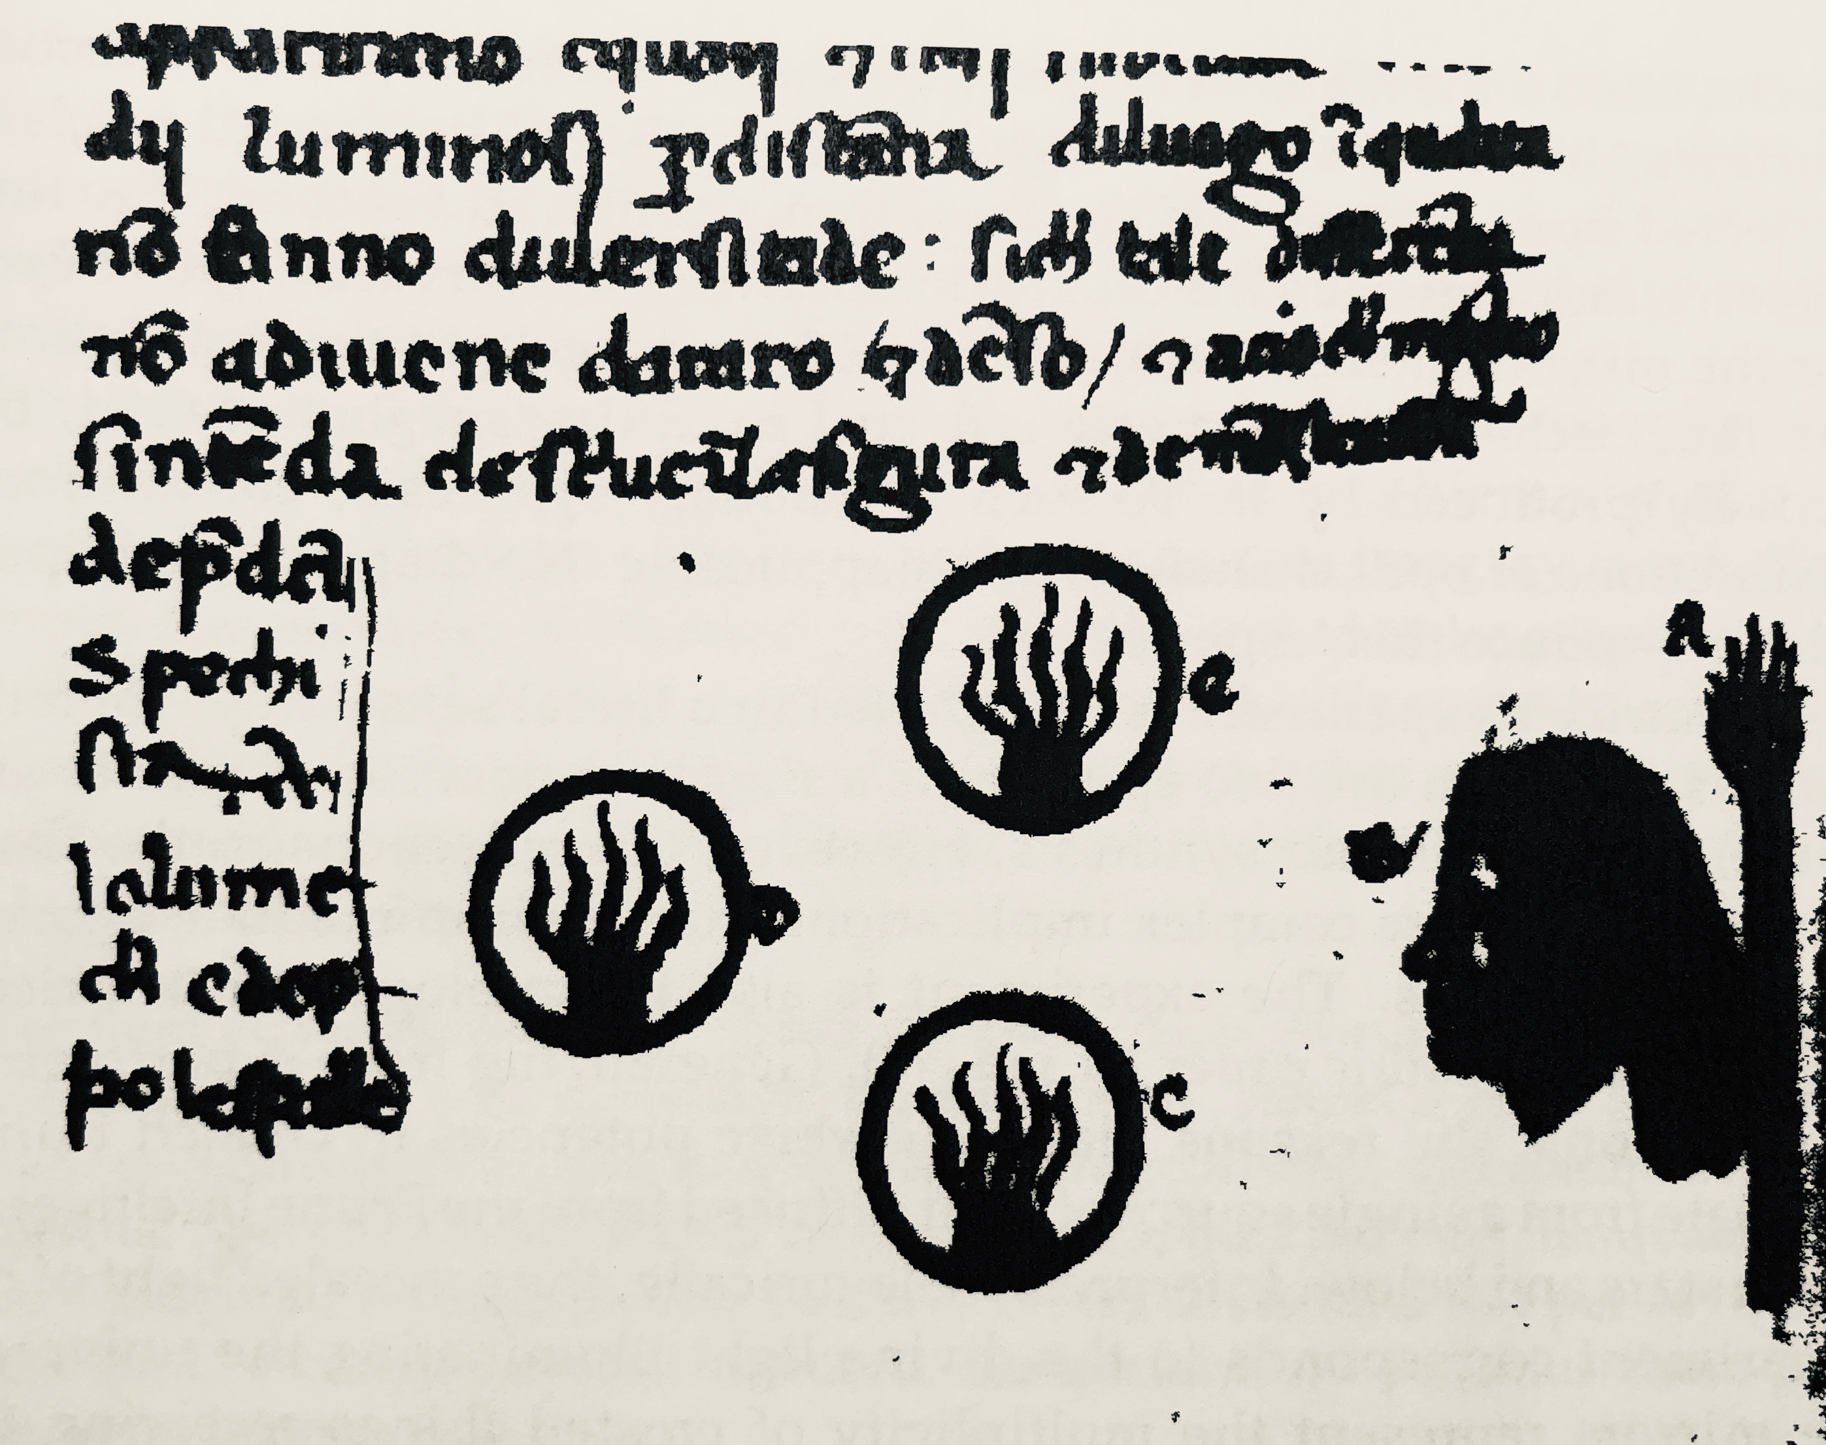
“Taking three mirrors, place a pair of them/at equal distance from you; set the third/midway between those two, but farther back./Then, turning toward them, at your back have placed/a light that kindles those three mirrors and/returns to you, reflected by them all./Although the image in the farthest glass/will be of lesser size, there you will see/that it must match the brightness of the rest.”
Paradiso, Canto II, lines 97-105

Slide 14
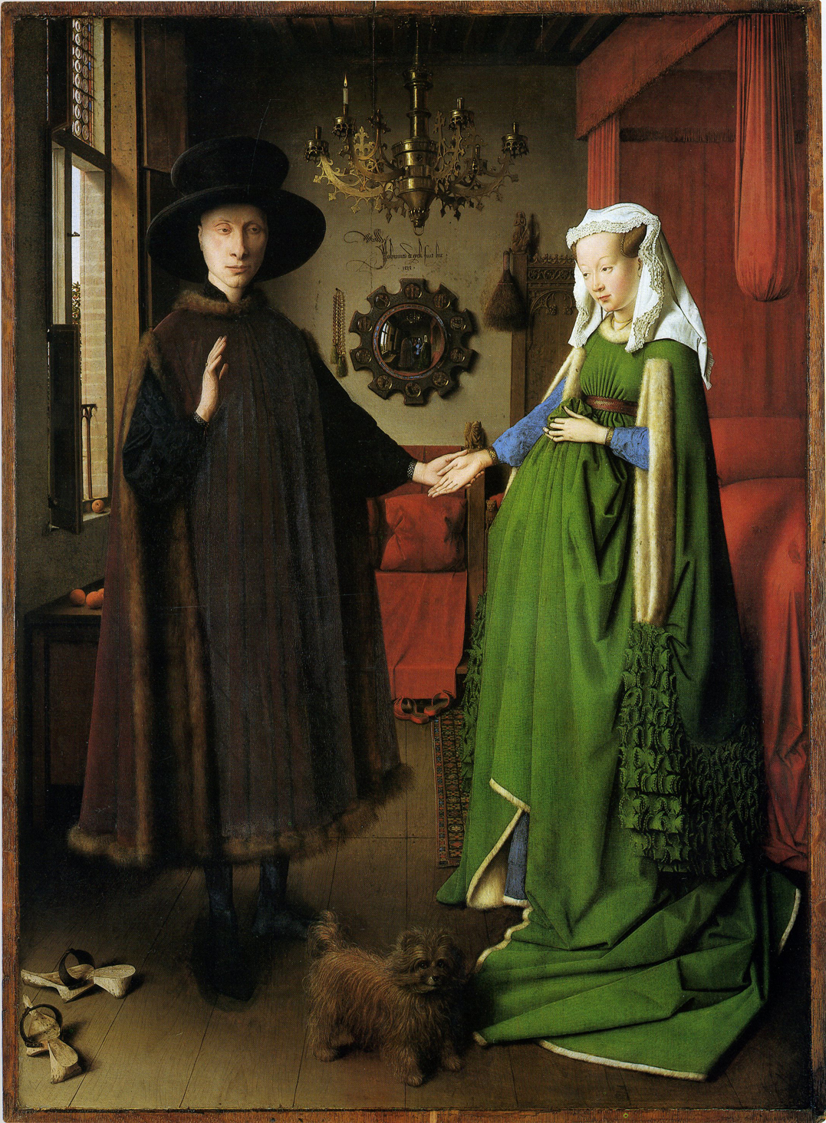
Jan van Eyck, Portrait of Giovanni Arnolfini and His Wife Giovanna Cenami (1434)
Notes:
Portrait of Giovanni Arnolfini and His Wife Giovanna Cenami

Slide 15
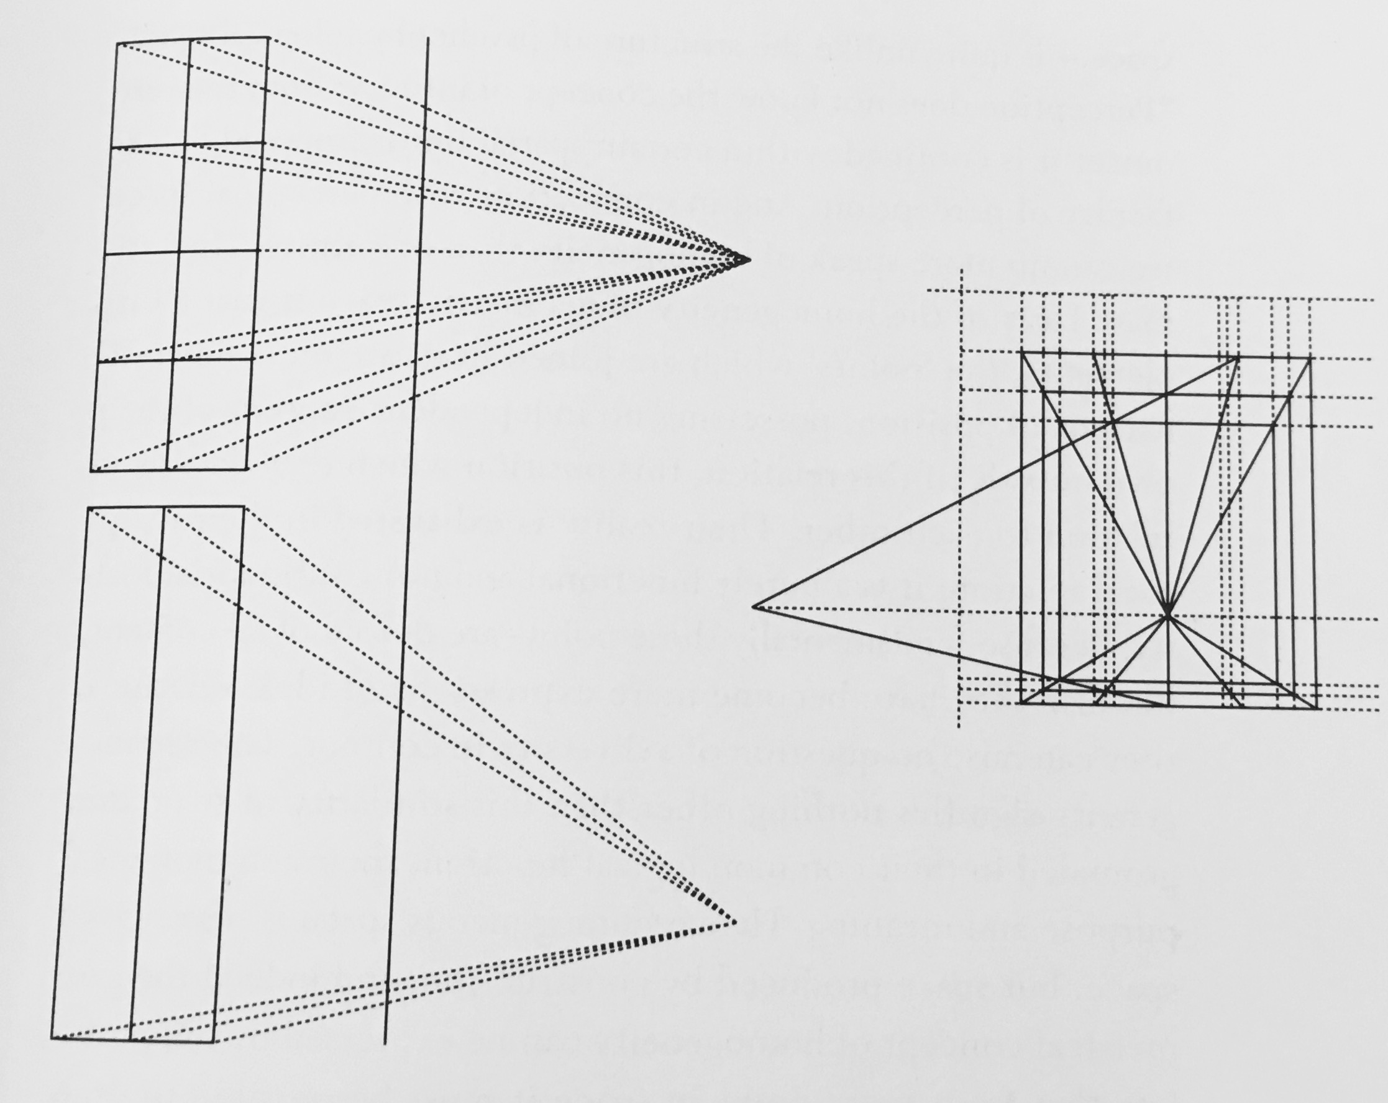

Slide 16
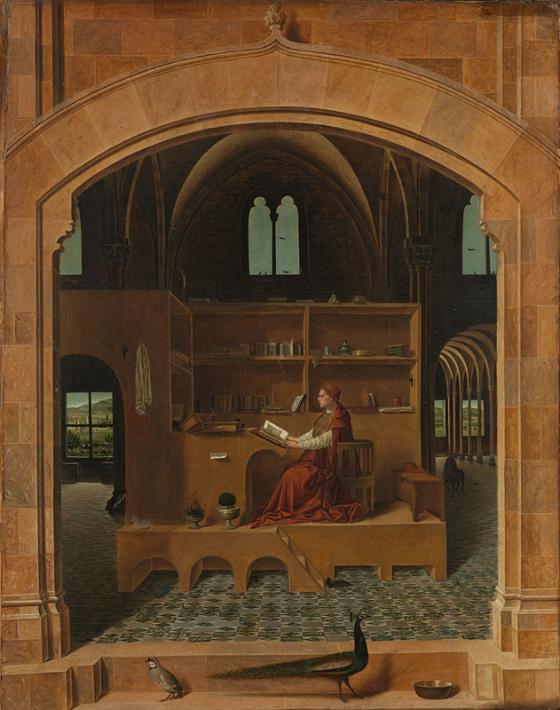
Antonello da Messina,
St. Jerome in His Chamber (1475).

Slide 17
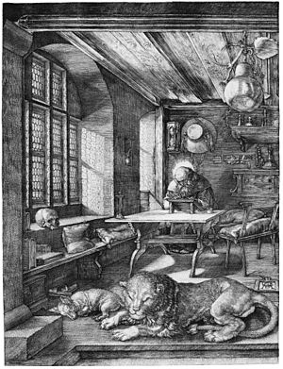
Albrecht Dürer,
St. Jerome in his Cabinet (1514)

Slide 18
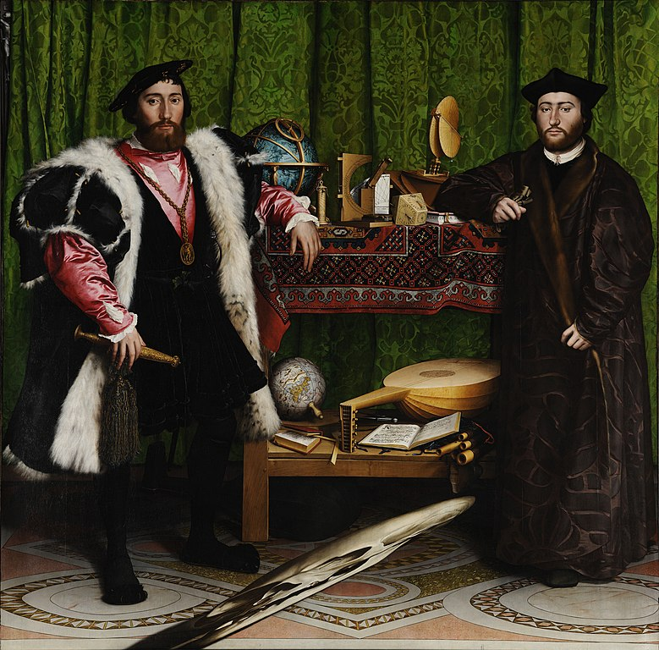
Hans Holbein, The Ambassadors (1533)

Slide 19
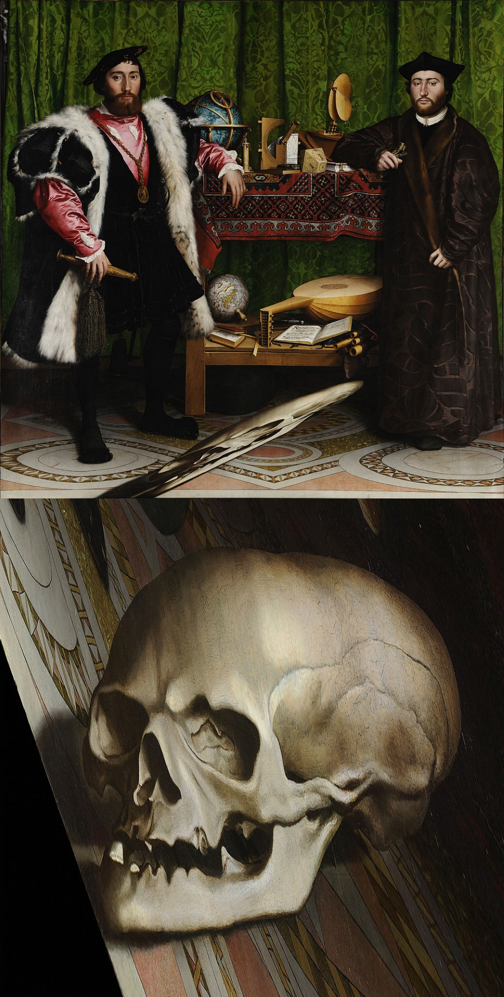
From central vantage point
From eccentric vantage point
(detail)

Slide 20
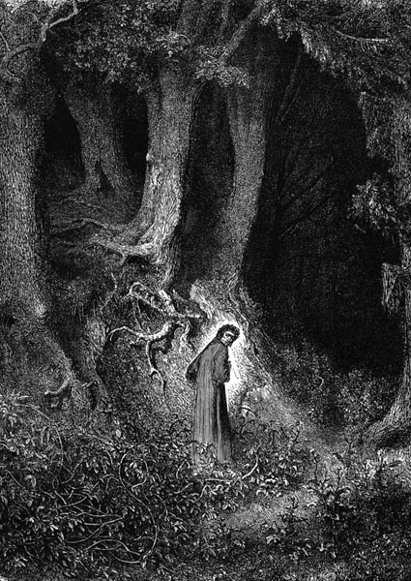

Slide 21
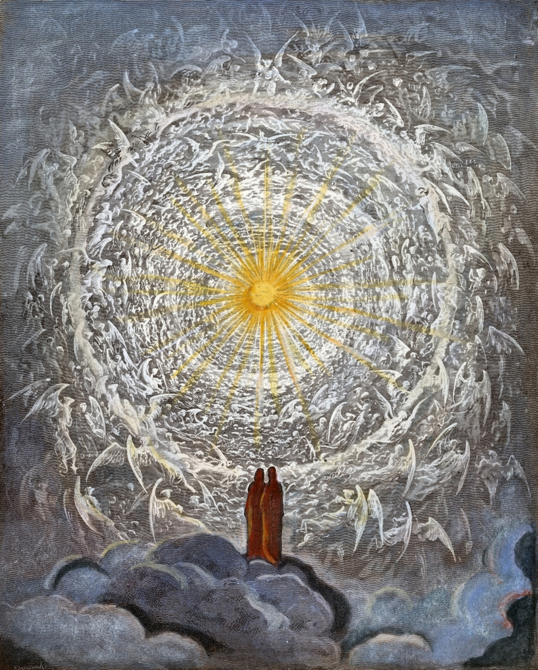
“The glory of the One who moves all things/
permeates the universe and glows/
in one part more and in another less.”
(Paradiso Canto I, 1-3)

Slide 22
O radiance of God, through which I saw the noble triumph of the true realm, give to me the power to speak of what I saw! Above, on high, there is a light that makes apparent the Creator to the creature whose only peace lies in his seeing Him. The shape which that light takes as it expands is circular, and its circumference would be too great a girdle for the sun.
All that one sees of it derives from one light-ray reflected from the summit of the Primum Mobile, which from it draws power and life. And as a hill is mirrored in waters at is base, as if to see
itself—when rich with grass and flowers—graced, the light, encircling it, I saw, mirrored, all of us who have won return above.
Paradiso, Canto XXX, lines 106-114

Slide 23
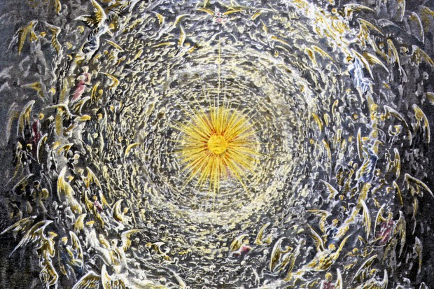
There, near and far do not subtract or add;
For where God governs with no mediator,
No thing depends upon the laws of nature.
-Paradiso, Canto XXX, lines 121-123

